Slide 1
PDGHAD
Rock Revetment Project
FAQs

Slide 2

What is the PDGHAD?
Was formed in October 1998 to maintain and repair improvements that protect properties within the District.
Comprised of two zones. Zone 1 is responsible for the rock revetment seawall, and all associated costs and expenses. Includes all members of the District.
Zone 2 is responsible for maintenance of the sheet pile river wall, and all associated costs and expenses, and includes all members of the Pelican Homeowners Association.
The Zone 1 seawall was designed to reduce potential damage to homes and related infrastructure due to coastal erosion and coastal flooding from a 30-year storm event. While the initial construction costs for the seawall were paid by the front-row lot owners, the Pelican Condominium owners and Cypress Townhouse owners, Zone 1 of the GHAD now has responsibility for maintaining and repairing the seawall, to the extent that District property owners approve funding for such maintenance and repair activities.
The affairs of the GHAD are managed by a five-person Board of Directors, which currently includes John Cullen, David Ferrari, Raphael Kraw, Michael Butner and Patrick Dobbins.

Slide 3

Why is a new assessment necessary?
The only means by which the District can obtain funds for ongoing operation, maintenance and repair expenses is through assessments imposed on property owners within the District’s boundaries.
Current assessments on District properties address administrative and operating costs for Zone 1 and Zone 2, the creation and maintenance of a fund for emergency seawall repairs, and the repayment of existing District costs and debt.

Slide 4

What is the purpose of the new assessment?
The District will be seeking approval of a new assessment to fund the long-needed repair and restoration of portions of the seawall.
After years of effort, the District has been able to obtain approval from Santa Cruz County of a Seawall Maintenance and Repair Plan that allows the District to pull a grading permit for repair and restoration activities.
The Project proposes to rebuild and restack portions of the seawall to essentially restore and preserve the original seawall configuration using rock previously placed for emergency seawall repair on California State Parks property in 2003 as well as rock that has been displaced over time within and adjacent to the seawall itself.
The Project is planned to impact a 1,900 foot long segment of the seawall.
Unless the involved repair and restoration work is performed, there is an ongoing risk that weakened portions of the wall will be breached during upcoming storms, causing flooding and possible structural damage to homes throughout the District.
Once completed, the Project will provide reasonable coastal protection to homes at a significantly lower cost than other major repair and replacement projects considered by previous District Boards.

Slide 5
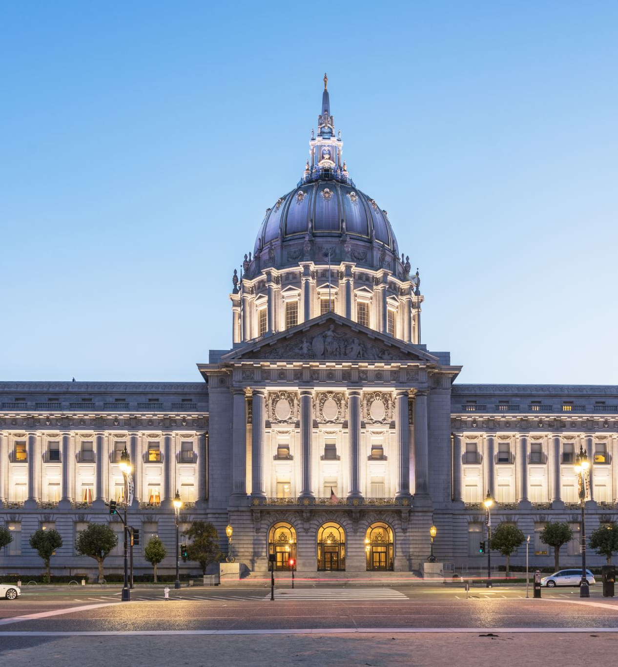
Why is the process so complicated?
The District’s ability to impose assessments is subject to both the provisions of the California Public Resources Code and Proposition 218, a statewide Constitutional initiative, which was approved by the voters at the November 5, 1996 general election.
Proposition 218 added Article XIII D to the California Constitution, and that Article requires that all new or increased assessments in any special district must be approved by a weighted majority vote of the property owners within the district.
Ballot and election procedures will be sent with the ballots mailed to all property owners.

Slide 6
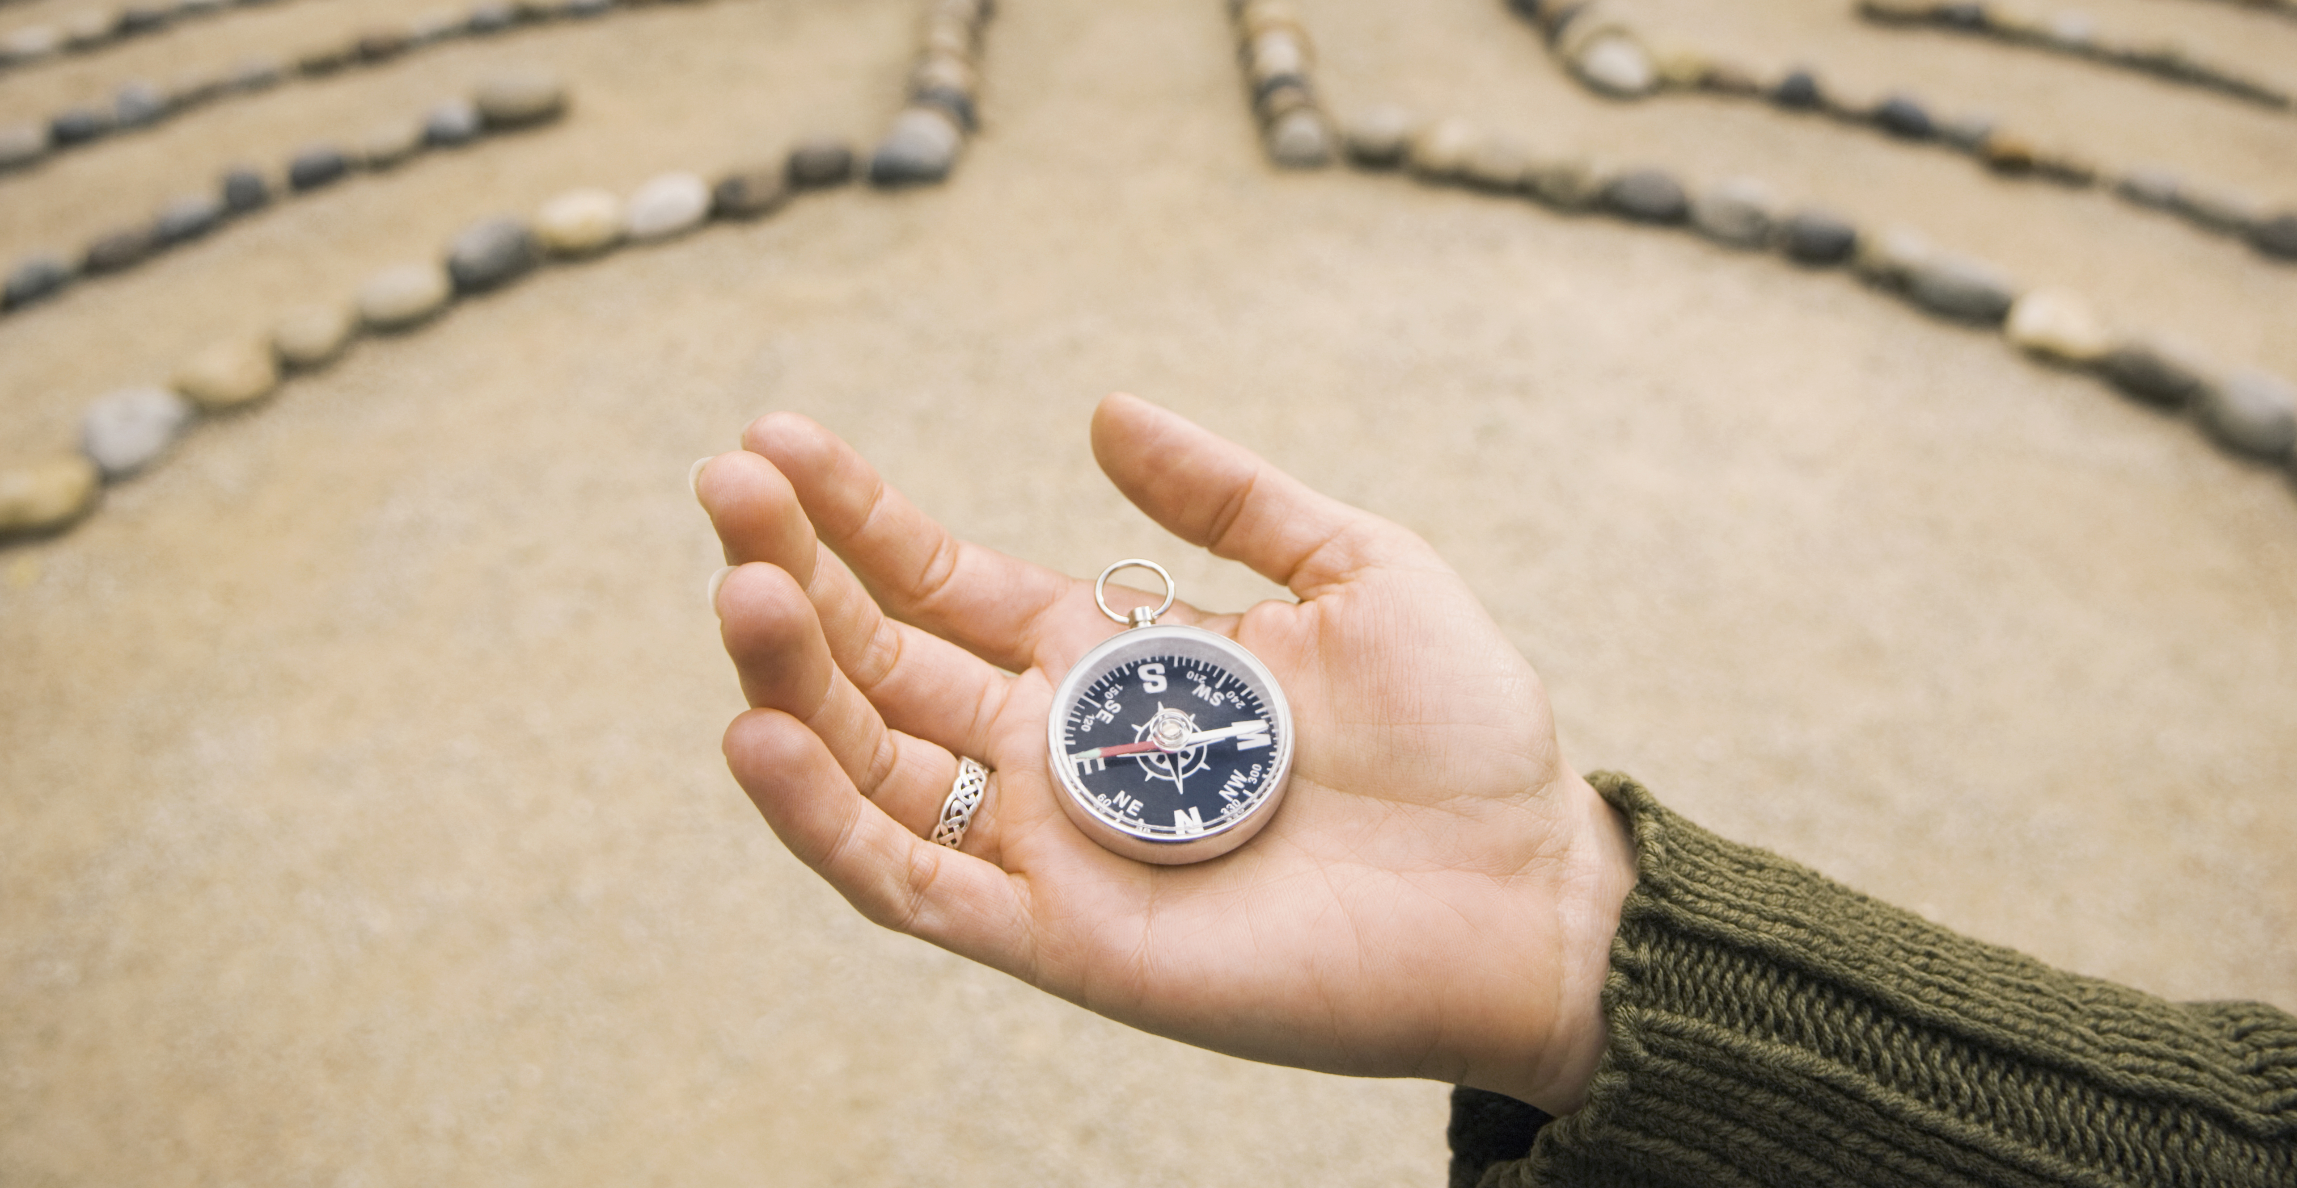


What is the duration of the assessment?
The new assessments to cover the District’s Seawall Maintenance and Repair Plan Project would be initiated by submitting an amended assessment roll to the County in August 2024 and would appear on your property tax bill, due in December of 2024.
The increased tax revenues would be available to the District in March of 2025. Thereafter, on an annual basis for a period of not to exceed nine additional years.
The District will provide notice of its intent to collect assessments for the Project in accordance with an approved assessment schedule.

Slide 7
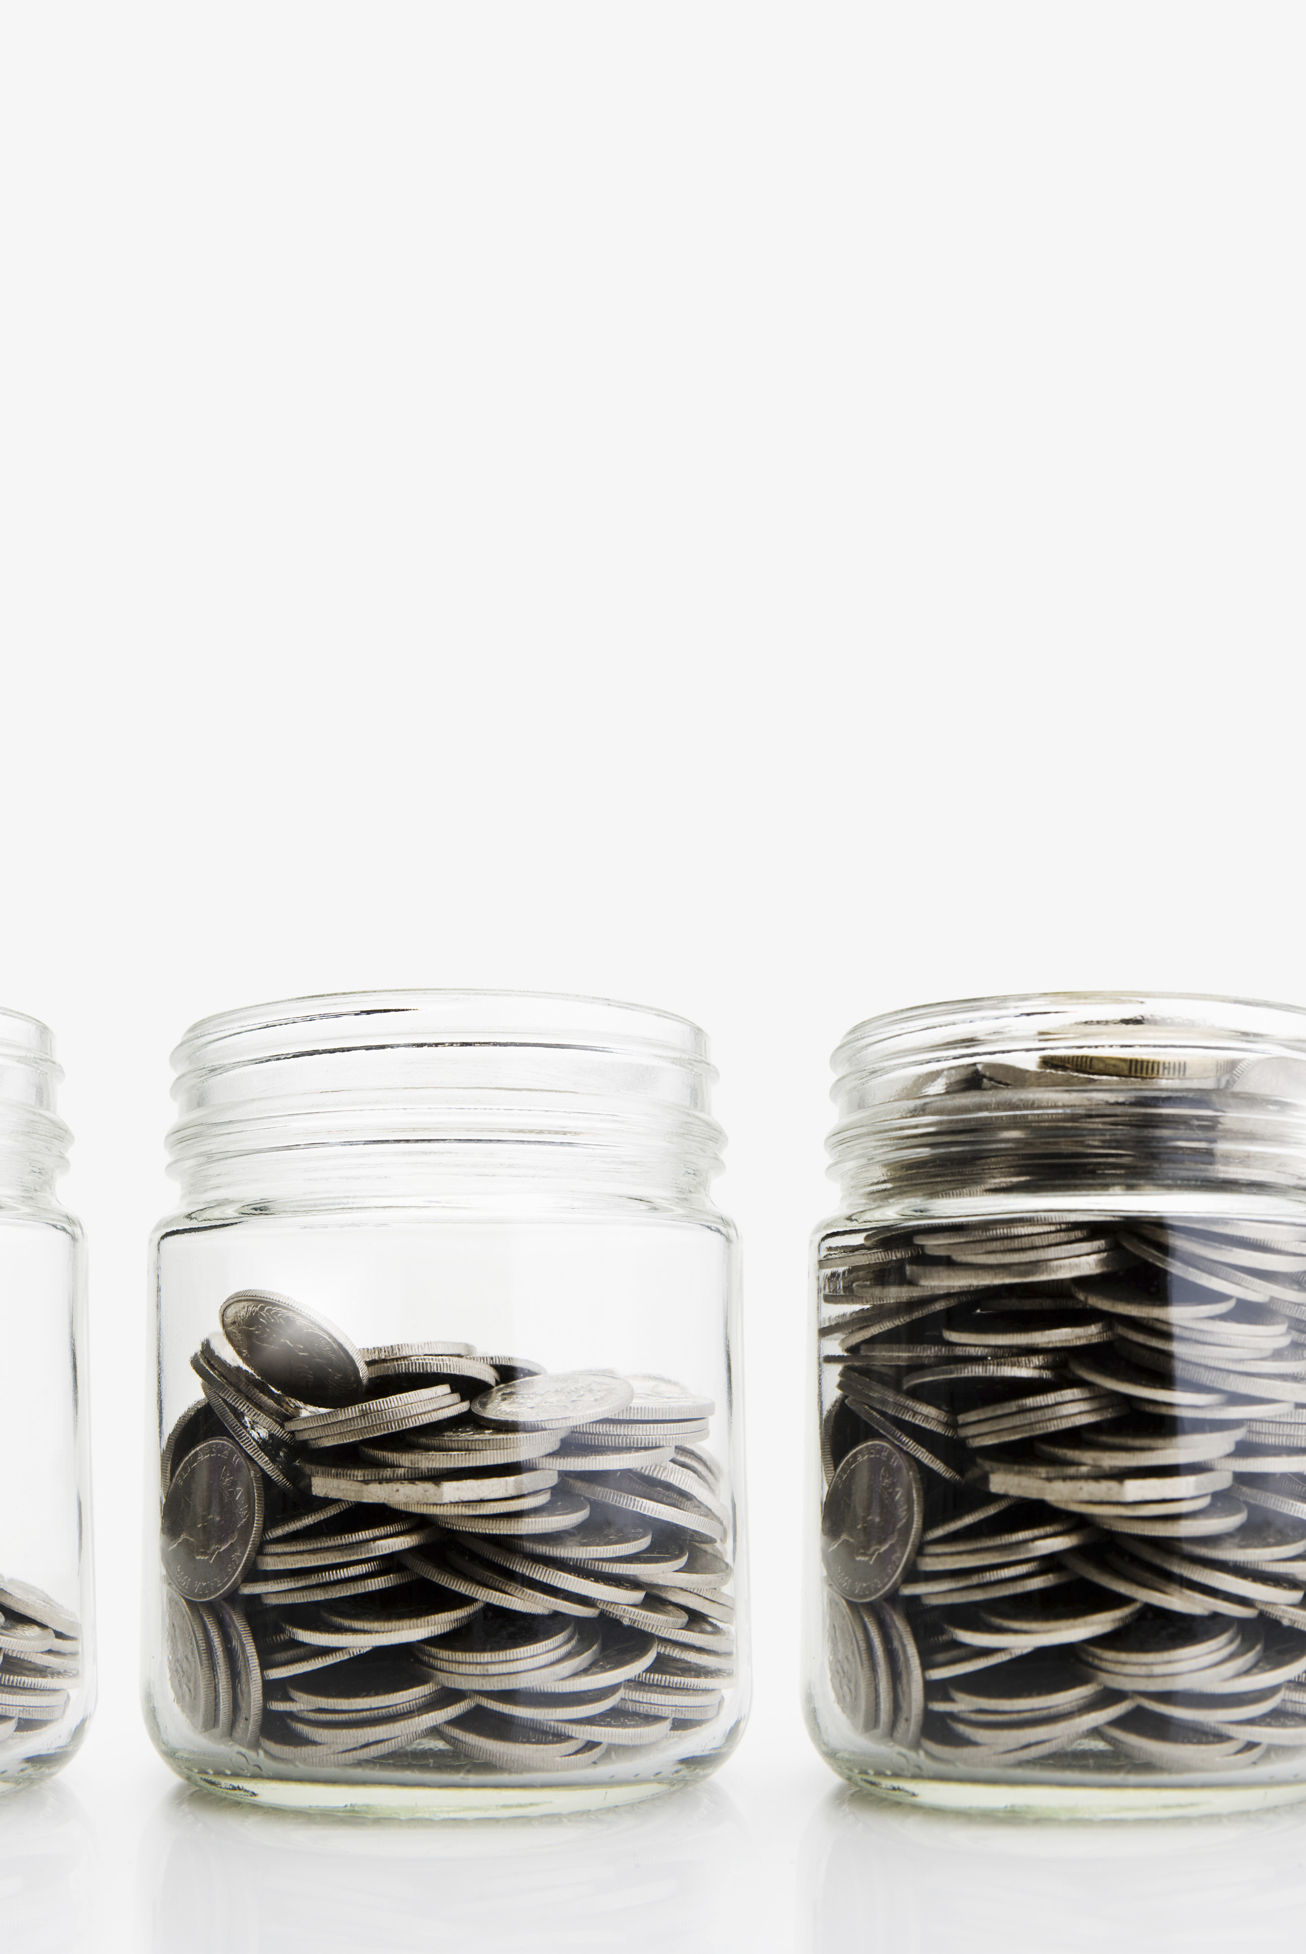
What is the amount for each property?
The new assessments, as calculated by the District’s consulting engineer Hayley & Aldrich, Inc, are set forth in the Cost Allocation tables in the Engineer’s Report.
Assessments would be subject to collection on an annual basis for a total period not to exceed ten years. The assessments have been calculated for a payback period of ten years based on an estimated project cost of 3.5 million. Assessments will be subject to reduction if the actual Project costs are less than 3.5 Million.

Slide 8

How were the assessments calculated?
The District has obtained an Engineer’s Report from Hayley & Aldrich, Inc., which allocates the costs of the Project to all properties in the District in proportion to the benefit received. A copy of the Engineer’s report may be obtained on the District’s website: pdghad.org or from the District’s Clerk, Sarah Mansergh, at (831) 818-9253 or pdghad@gmail.com. The schedule for allocating costs was adopted by the Board for the initial assessment election in 1999 and is described below.
For Zone 1, all costs for the seawall are allocated between three major groups, the house owners, the Cypress Townhouse owners and the Pelican Condominium owners in proportion to the length of the seawall in front of those respective properties. (Houses 75.45%, Cypress 11.84%, Pelican 10.18%; the Pajaro Dunes Homeowners Association pays 2.5% for the stairways property.) All members of the Cypress Project and the Pelican Project share the costs of the seawall in front of their respective project areas equally. For the portion of the total costs allocated to the house owners, 75.45%, the basis for the allocation is calculated on property proximity to the ocean hazard (85% to front-row houses, 10% to second-row houses and 5% to back-row houses). In addition, the shares of the front-row houses vary by a factor of two to one, depending on the width of the lot.
The District is not proposing Project financing via a separate Zone 2 assessment.

Slide 9

Will there be public meetings?
Yes-Today April 6th, 2024 at 10am in the Meadow Room
May 18th, 2024 at 9am in the Meadow Room or Board Room
June 1st, 2024 at 9am in the Meadow Room
Mid-July, 2024 in the Meadow Room

Slide 10

How can I learn more about the Project and proposed assessment?
Go to the Rock Revetment Project and 218 Election pages on our website:
www.pdghad.org

